Slide 1
Riverwatch Cheerleading
2025-2026
Information

Slide 2
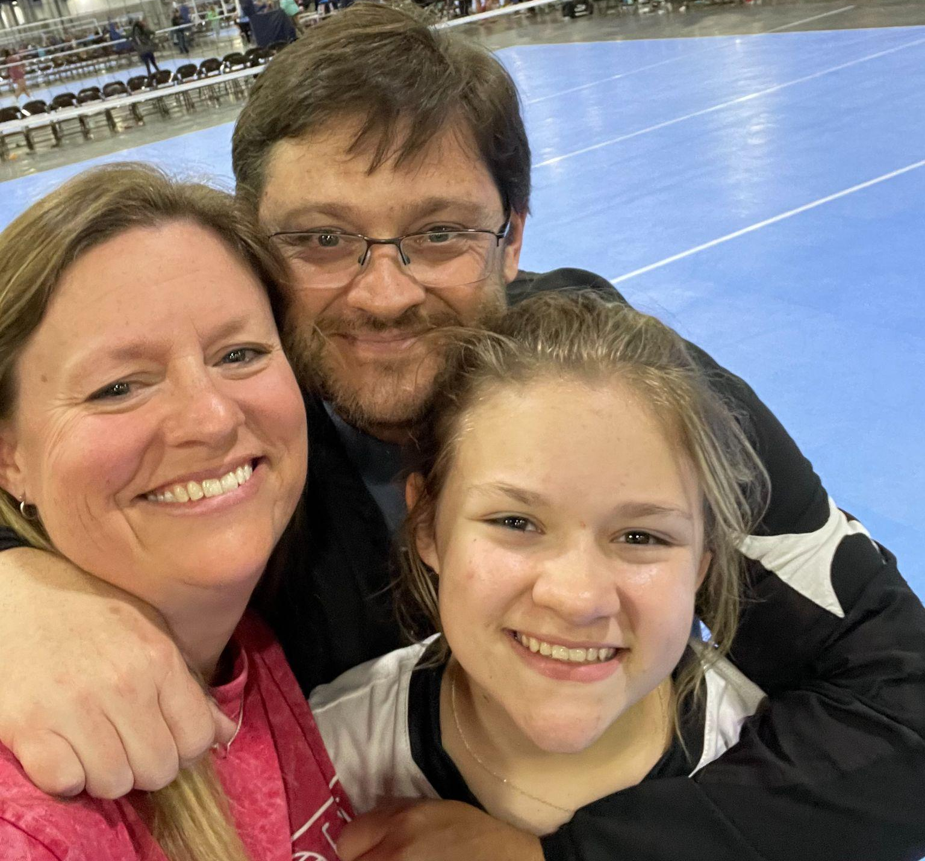
Cheer Coaches
Mrs. Heather Lundy
Hi there! I am So excited to be here and be a part of RMS Cheer! I have been a teacher for 29 years, coaching multiple sports (including Cheer at the high school level). I am a Health/PE teacher for 6th/7th/8th Grades and the Athletic Director here at RMS. Having moved from South Florida, I have lived in Georgia for 19 years with my husband Dan (he’s also a teacher) and we were joined by our daughter, Jo, in 2008, she is almost 17 years old. I love adventure and doing things at the last minute. This is going to be a great season to be a Panther!
Mrs. Haley Miller
Hi! I am so excited to be joining RMS Cheer this season! This will be my third year at the River. I cheered throughout middle middle school before joining the cross country and swim teams in high school. I am an 8th grade Physical Science teacher. I just got married in December and adopted a black lab mix named Archie this spring. I love running, reading, and traveling. It's going to be a great season!

Slide 4
Requirements
All completed forms given in tryout packet
Application
Emergency Release
Cheerleading Program Guidelines
Report Card
Current physical (within the year)
Academic Eligibility
Failing 2 or more classes
Checking second semester grades (Spring 2025)
Checking first semester grades (Fall 2025) for Basketball

Slide 5
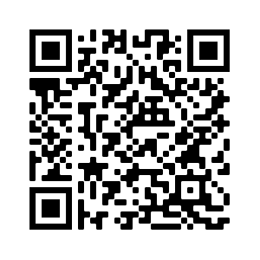
We Need You to Sign Up for
Dragonfly
We are moving to a paper free
Sports medical form system in
Forsyth County. Please take a
moment and set up an account
if you haven’t already.
PLEASE COMPLETE
CODE: E97DGG

Slide 6
Expectations
Promote and uphold sportsmanship, school spirit, personal & academic pride, and respect & kindness to all.
Participate in all fundraisers and community service activities.
Maintain high academic standards
Participate in all pre/post game activities and preparations.
Attend all games and practices. We understand there are emergencies, come talk to us. We will be more flexible due to competition cheer and other sports like RMS BB.

Slide 7
Costs
We are one! One team. One Family.
Dues for both Seasons: $600
Mypaymentsplus
One full payment OR make 3 installments:
May 30th-$200, August 30th -$200, September 30-$200
Includes: practice outfit, cheer shoes, football season shirt,BB
long-sleeved top, Jacket, backpack, bow, Sports bottle,
Game Day meals, transportation, camp, banquet, uniform
cleaning/storage, etc.
Parents need to purchase: black racerback sports bra and black
shorties

Slide 8
Football
Summer Dates
Camp: July 8-10th
9am-12:30pm
Arseneau Studios: 8th and 9th
Sharon Elementary: 10th
Half-time performances;
work on cheers; banner painting and team building activities
Will start practice on Aug 7th @ 4pm-5:30pm
Practices
Mon/Thur. 4:15-5:30 PM
Games
Tuesdays at 6:30
-You will stay after school
-Need to be picked up at the game
FIRST DAY OF SCHOOL: UNIFORM
*Unexcused Absences- Missing practice
will result in sitting during games.

Slide 9
Basketball
Important Dates
Mid-October – New Choreography w/tryout dance
Practices
Practice one day a week
CHOOSE ONE GAME to Cheer:
Tues or Thurs games(some wednesdays)
ONLY home games
Games begin in early November and go through January
**Missing practice will result in sitting during games.

Slide 10
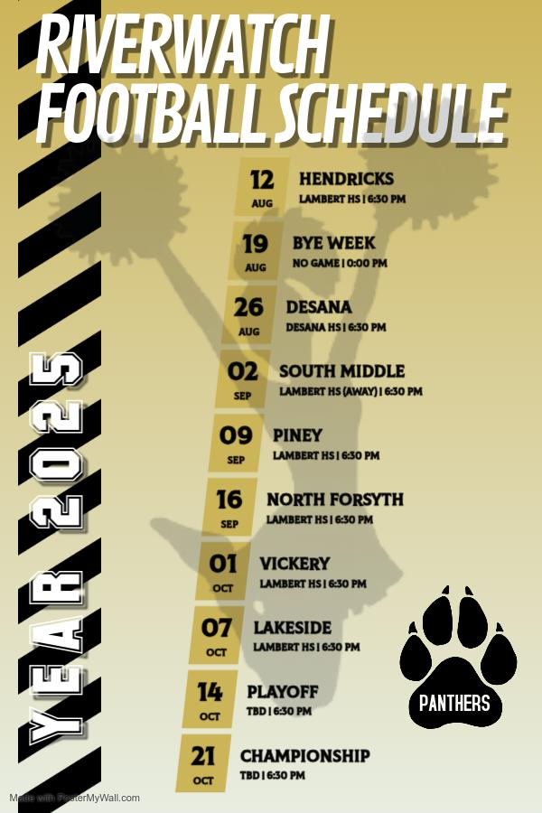
Important Dates
Cheer Camp -
July 8-10th; 9-12:30
First Practice -
August 7th; 4:15-5:30
Team Pictures…
Not sure yet
First Game -
August 12th (HOME)

Slide 11
Expectations
1. Uniforms shall not be altered in any way without the permission of the coach.
2. Uniforms may be worn ONLY in conjunction with school events. Uniforms will not be worn outside of these unless the entire team is together.
3. Jewelry of any kind may not be worn during practices or games. This is for safety reasons and is a National Cheerleading Rule. (Medical alert charms and religious medals are exceptions but must be taped to the body.)
4. Hair must be pulled back during all practices and games. High ponytail with bow DURING games.
5. Make-up and hairspray must be kept to a minimum and is subject to the approval of the coach.
6. Cheerleaders may not have nails that can be seen over the fingertips. Also, only neutral or school colored polish and there should be no writing on the hands, legs, or body.
7. Team members shall remain in uniform during the entire event.
8. Lost or damaged uniforms are the responsibility of the cheerleader. Therefore, they must incur the cost of replacing the uniform.
9. Even if benched or not cheering in a game, cheerleaders must wear their uniform.

Slide 12
Disclaimer
Picking the team is like putting together pieces of a puzzle.
Just because you have made the team in the past does not guarantee you a spot next year.
Remember, an RMS cheerleader must have PRIDE and promote good sportsmanship and school spirit. Smile and have fun!!

Slide 13
We Need Your Help…
We need 2 Cheer Moms or Dads!!
Please sign up… we need
1-7th grade parent per game
1-8th grade parent per game
* 1 bring a snack for 23 and 1 bring drinks-PLEASE Communicate with one another.

Slide 14
Parents and girls,
Don’t forget to sign up for Remind-Text @rmschr2526 to 81010

Slide 15
Questions???
Please email us at :
Heather Lundy-
hlundy@forsyth.k12.ga.us
Haley Miller-
hmiller@forsyth.k12.ga.us

